Slide 1
W
E
R
M
I
N
A
L
M
A
S
T
E
R
'
S
H
A
N
D
B
O
O
K
Version 1.0
by
Wormle, the Worm Wizard
WRML
Disc 1
WRML
WRML
Disc 2
Copyright 2013 Mark Masse

Slide 2

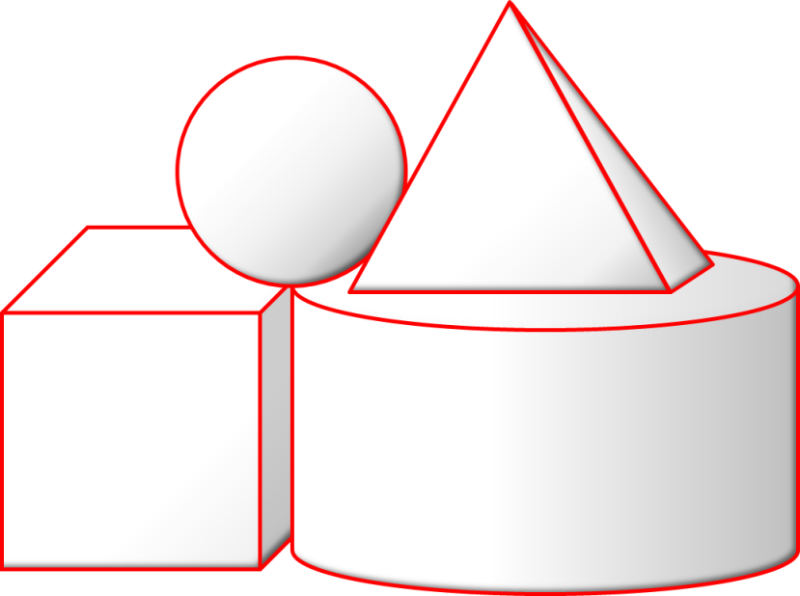
The Map
Welcome to the Werminal Master’s Handbook. This book helps guide weary travelers through Werminal, WRML’s terminal-based data modeling tool.
Below is the application’s Map, with a box per screen and arrow to indicate available work flows.
Splash
Screen
You are here
Activating the Werminal Help will bring you to this documentation.
Main
Menu
Help
New
Dialog
Model
Window
Print
Preview
List
Dialog
Open
Dialog
Choices
Dialog
To learn more…
This document relates to WRML, the Web Resource Modeling Language. Check out WRML.org for more information.
Copyright 2013 Mark Masse

Slide 3
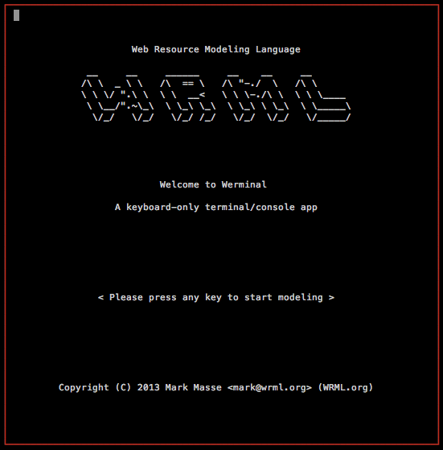
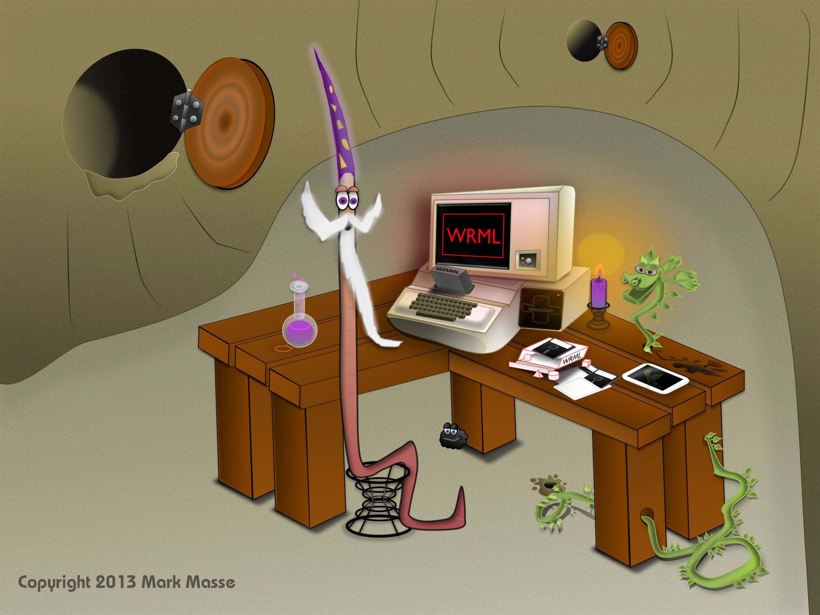
Splash Screen
Upon start-up, Werminal greets users with an introductory screen. The splash screen explains that Werminal is a keyboard-driven, terminal window based application.
To move things along, Werminal prompts users to “Press any key to start modeling”.

Slide 4
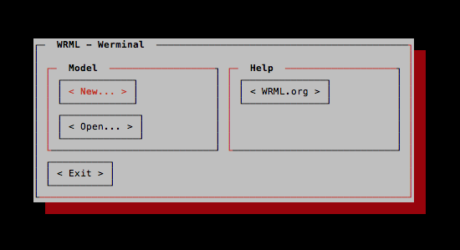
Main Menu
After the splash screen is dismissed (with any key), Werminal displays the Main Menu screen. This screen is home to the application’s two primary features: creating new models and opening existing models.
< New… >
This action displays the New Dialog screen, which prompts the user to select a Schema for the new Model.
< WRML.org >
This action navigates a web browser app to this help documentation.
< Open… >
This action displays the Open Dialog screen, which prompts the user to select a Schema and enter Keys to identify the Model to be opened.
< Exit >
This action quits Werminal, returning control back to the parent console or terminal process.
Copyright 2013 Mark Masse

Slide 5
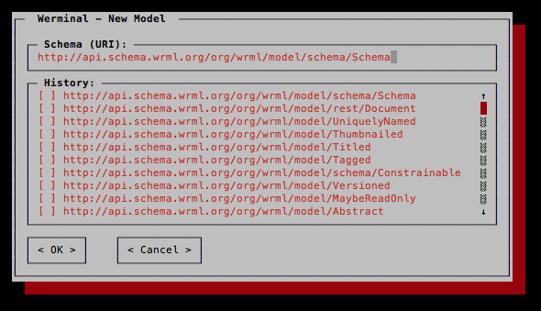
New Dialog
The New Dialog screen asks users to decide what type of data model that they wish to create. This decision is made by typing, or selecting from the History, the URI of the Schema to be instantiated (with the option of saving/persisting the new model later).
Schema URI
The New Dialog’s Schema text field allows users to enter a URI value to identify the type of the new Model to create. A Schema is metadata document that describes a set of named “slots” (name/value pairs) that may be present in any Model conforming to the Schema. A Model is an instance of a Schema. NOTE: As a REST-oriented system, WRML’s Schemas are inherently multifaceted with representation as JSON, XML, Java, SQL, etc.
Schema URI History
Recalling and typing URIs is not very fun. The history list helps make the Werminal program more user friendly by asking humans to only type a given Schema URI once. Pressing Space or Enter checks the box in the selected row of the history list and sets the URI as the Schema text field’s value. NOTE: Hitting the Enter key again on the selected and checked row will trigger the < OK > action.
< OK >
This action confirms the choice of Schema and displays a Model Window screen with the new (blank) model ready to be filled in and (optionally) saved.
< Cancel >
This action returns users to the Main Menu screen.
Copyright 2013 Mark Masse

Slide 6
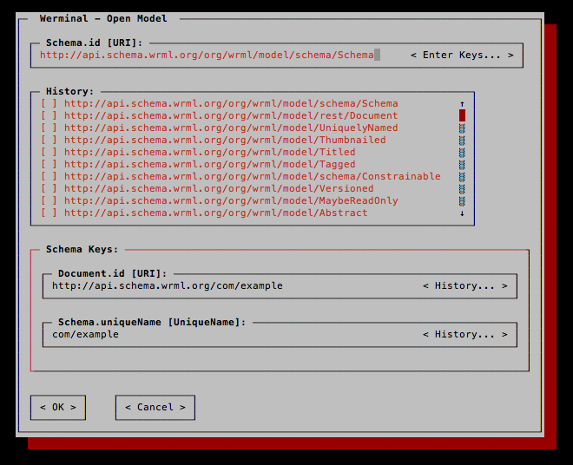
Open Dialog (part 1)
Triggering the < Open > action from the Main Menu will bring users to the Open Dialog screen. The bulk of this screen is similar to the New Dialog screen. It asks users to specify the type of model to be opened. Once the Schema URI has been entered, the screen displays the Keys entry form, which is covered in detail on the next few pages.
Splash
Screen
Main
Menu
Help
New
Dialog
Model
Window
Print
Preview
List
Dialog
Open
Dialog
Choices
Dialog
You are here
Copyright 2013 Mark Masse

Slide 7
Open Dialog (part 2)
Opening Models with Keys
The lower portion of the Open Dialog features the key entry form area. This form is used to identify the model instance to be opened. The form dynamically arranges itself to provide the Schema-appropriate text fields needed to enter each possible key value.
Since Keys are an integral part of WRML, they warrant a proper introduction.
Modeling Uniqueness with WRML Keys
The WRML system uses Keys to represent the idea of IDs (identities) and to formalize the concept of identity domains or spaces. WRML allows clients to “open” (aka GET) model instances by one or more key values, which are opaquely collected together as Keys.
As a composition-oriented system WRML, aligns the notion of an identity space, such as the Web and its URIs, or the Universe and its UUIDs, with the concept of Schema inheritance. As a result, each WRML Schema may declare a key (thus declaring itself an identity space) by simply naming one (or more) of its own slots and/or inherited base Schema(s) slot(s).
Example Key Declaration
A JSON-formatted GroceryStore Schema declares its key slot(s) like this:
“keySlots” : [ “storeCode” ]
When represented as a Java interface, the same WRML Schema declares its key slot(s) using the Key annotation, as shown below:
@Key(slots = { “storeCode” })
public interface GroceryStore
Both express that GroceryStore model instances may be uniquely identified (and indexed) by their storeCode slot’s value.
Model
GroceryStore
{ storeCode = 42 }
Copyright 2013 Mark Masse

Slide 8
Open Dialog (part 3)
Key Inheritance
To participate in a given identity space, a Schema simply claims the appropriate Schema as a basis (a base Schema) for itself. For example, if models of a given Schema should have unique identities on the Web (e.g. as a REST API resource representations) then the Schema simply declares the Document Schema as a basis. As a result, its model instances will inherit the Document Schema’s declared Key slot, uri.
Similarly, if a model instance should be considered universally unique, with a UUID-based identity, then it’s Schema lists the UniquelyIdentified Schema as a basis and it gains the UUID-valued uniquelyIdentifed key slot.
The multiple interface inheritance nature of WRML base Schemas means that a given model may have zero or more keys that function as separate, possibly related identifier values.
Links and URIs
For REST API-oriented (top-level) Document models, WRML’s runtime automatically manages the translation of “internal” (surrogate) identity space identifiers (e.g. DB ids) to a REST API’s identity space. In other words, WRML automates the Link href values by leveraging the combination of key slot values and REST API design metadata.
{ uri = “http://…/…/stores/42” }
Model
Document
GroceryStore
{ storeCode = 42 }
Copyright 2013 Mark Masse

Slide 9
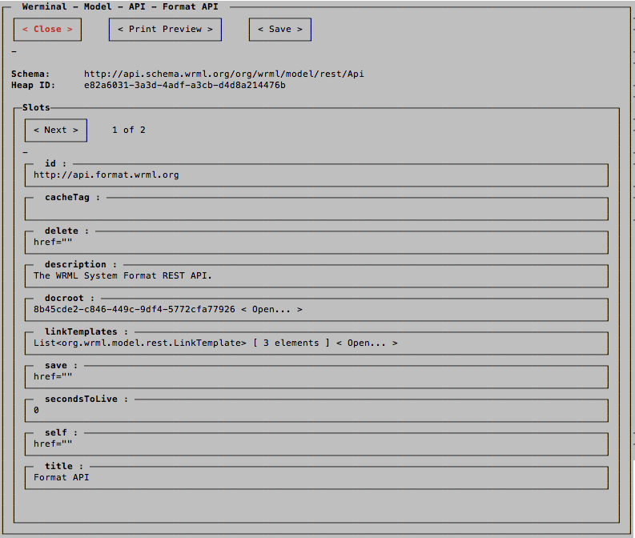
Model Window (part 1)
The Model Window is the Werminal application’s primary screen.
By leveraging the WRML core engine and Schema metadata, this screen facilitates viewing, editing, and saving data models of any type.
The screen shot below demonstrates that Werminal can also be used to open system models such as the built-in Format REST API’s model.
Model
Window
Print
Preview
List
Dialog
Choices
Dialog
Copyright 2013 Mark Masse

Slide 10
Model Window (part 2)
Slot Pages
The Model Window’s central feature are the slot pages, which list the model’s available slots in alphabetical order (with key slots ordered first). The Tab key cycles the input focus forward through the slots. Shift + Tab cycles the focus in reverse order. The Enter key will open the slot value type-specific editor as outlined in the table below.
Value Type
Value Format and Editor Support
Boolean
Enter toggles the value between true and false.
Date
Text format as defined by RFC 2616 (section 3.3.1).
Double
For decimal numbers like 3.12.
Integer
For integer values (no decimal point).
Link
Enter clicks the Link, opening the result in a new Model Window.
List
A linear sequence of any other Value Type (except List). Enter key to open List Dialog.
Long
For compatibility with long (large integral) values.
Model
For embedded models (models within models).
Enter on a blank opens the Model Value Initialization Dialog.
Enter on a model value will open it in a new Model Window.
Single Select
A text value drawn from a menu of choices (like an enum).
Enter key for Choices Dialog.
Text
A string of characters (with optional syntax constraint).
Copyright 2013 Mark Masse

Slide 11
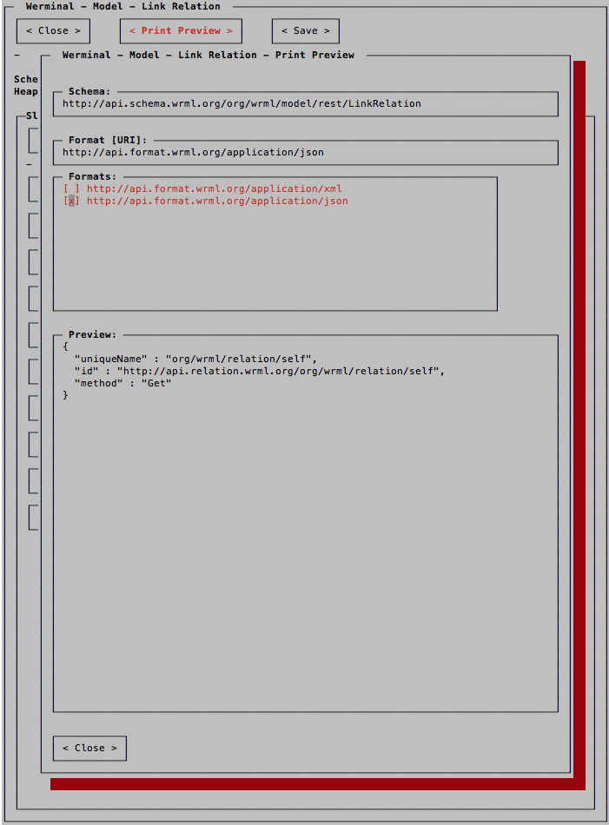
Model Window (part 3)
< Print Preview >
The
Copyright 2013 Mark Masse

Slide 12
Model Window (part 4)
< Save >
The
Copyright 2013 Mark Masse

Slide 13
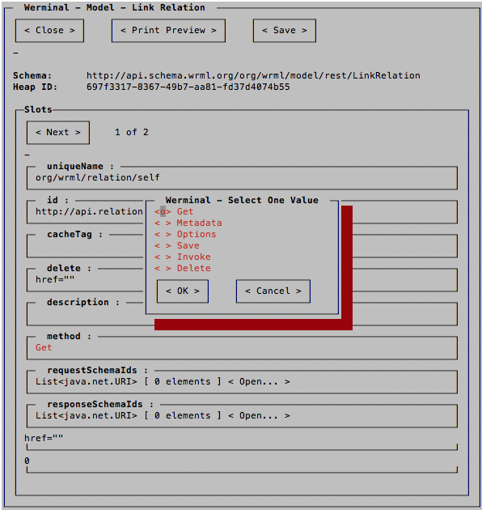
Choices Dialog
Title
The Single Select Value…
Copyright 2013 Mark Masse

Slide 14
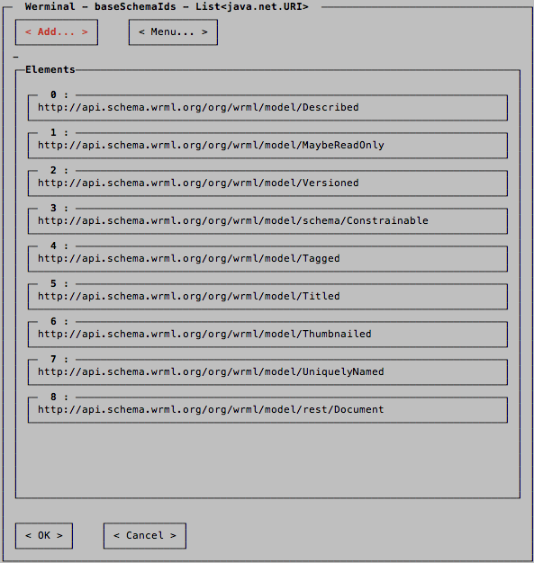
List Dialog
Title
The
Copyright 2013 Mark Masse

Slide 15
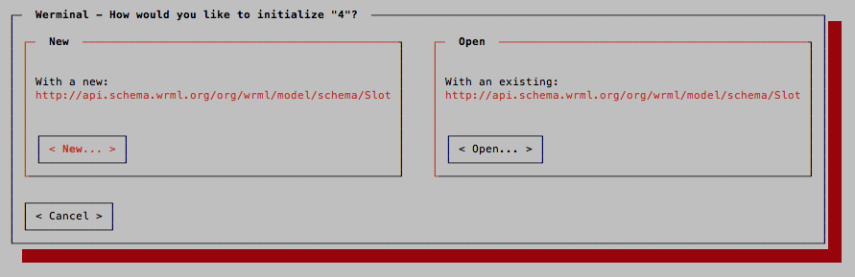
Model Value Initialization Dialog
Title
The
Copyright 2013 Mark Masse

